Slide 1

Segment Anything
Meta AI Research / Arxiv
신성구

Slide 2
Table of Contents
Introduction
Task
Model
Data
Experiments
Conclusions
AIoT Lab Meeting

Slide 3
Intro: What is Segment Anything?
AIoT Lab Meeting

Slide 4
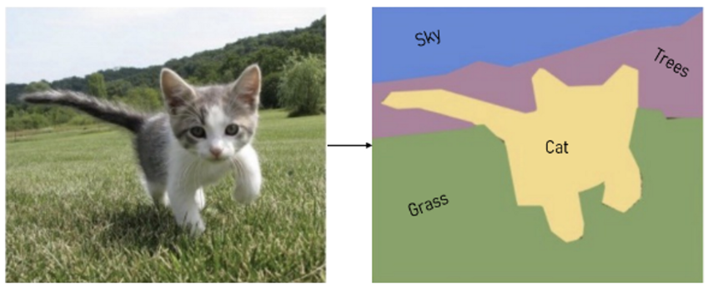
But First… Image Segmentation
Computer vision (CV) task that predicts the area of an object in an image as a “Mask”
Classification occurs in the pixel-level
Indicates the difficulty of the task!
AIoT Lab Meeting
Notes:
이미지 안에서 물체의 영역을 “Mask” 형태로 예측하는 computer vision task

Slide 5
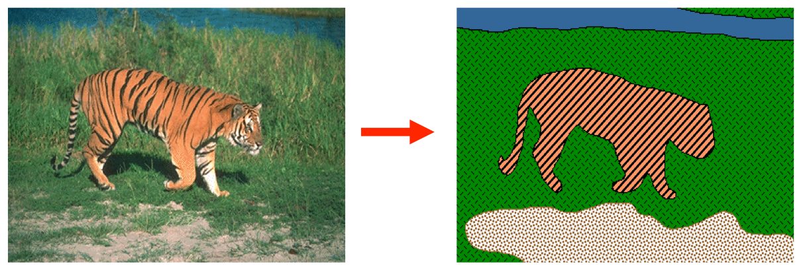
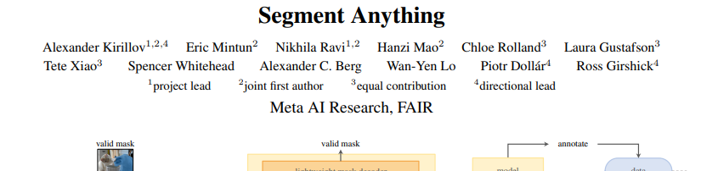
Motivation
LLMs achieved a major breakthrough in transfer & multi-task
GPTs (trained on Next Token Prediction) show very strong performance on a multitude of tasks
What about in the field of Computer Vision?
Need to create a new task, model, and data to accomplish
Segment Anything accomplishes baseline segmentation and performs better on new tasks
Compared to SOTA models designed specifically for those tasks
AIoT Lab Meeting
Notes:
Next Token Prediction으로 학습한 GPT가 온갖 Task를 잘한다
Computer Vision에서도 이런 만능 모델을 만들고 싶어서 task / model / data 를 개발했

Slide 6
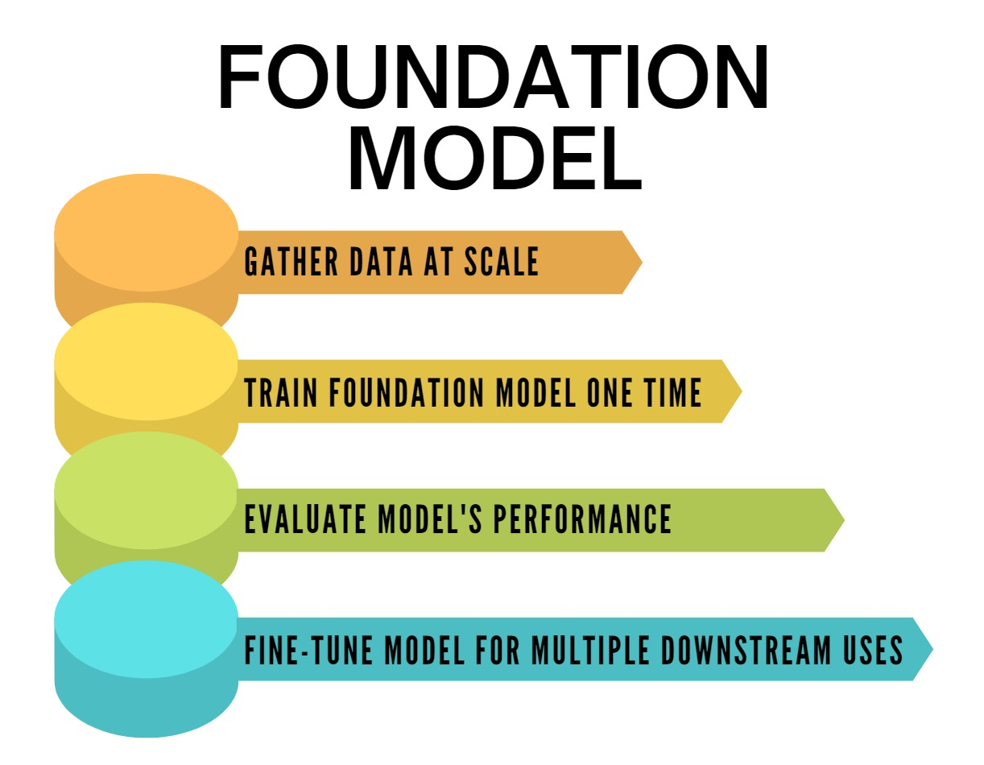
Foundation Model = "Paradigm for building AI systems"
Model trained on a large amount of data that can be adapted to many applications
LLMs (GPT) perform very well at Zero-shot / Few-shot generalizations
Prompt Engineering: Ability to create appropriate responses for various, new tasks
How to build a Foundation Model for Image Segmentation?
Create many tasks aimed to train on:
Generalization and prompt engineering
AIoT Lab Meeting
Notes:
대규모 언어모델(GPT): Zero-shot / Few-shot Generalization 잘한다
Prompt Engineering: 다양한 task에 대해 적절한 응답 생성
“Image Segmentation 분야의 Foundation Model을 만들어 보자!”
다양한 task에 대한 generalization + prompt engineering을 시도

Slide 7
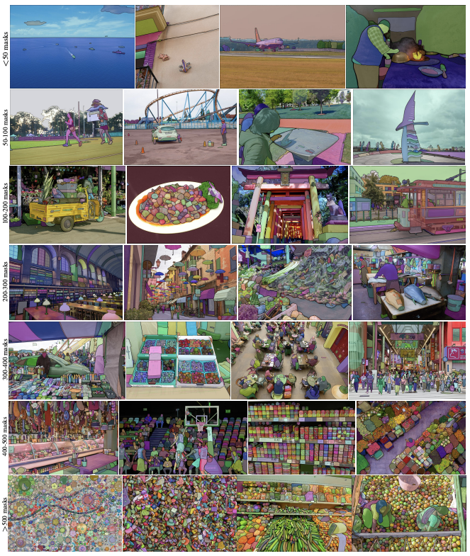
Starting Points
Task) Which tasks allow for the best zero-shot generalization?
Promptable Segmentation
Model) What should the model architecture be?
Image Encoder / Prompt Encoder / Mask Decoder
Data) Which dataset is appropriate for the Task / Model above?
SA-1B (11 million images + 1 billion masks)
AIoT Lab Meeting
Notes:
1,000,000,000

Slide 8
Task: Which task is best for zero-shot generalization?
AIoT Lab Meeting

Slide 9
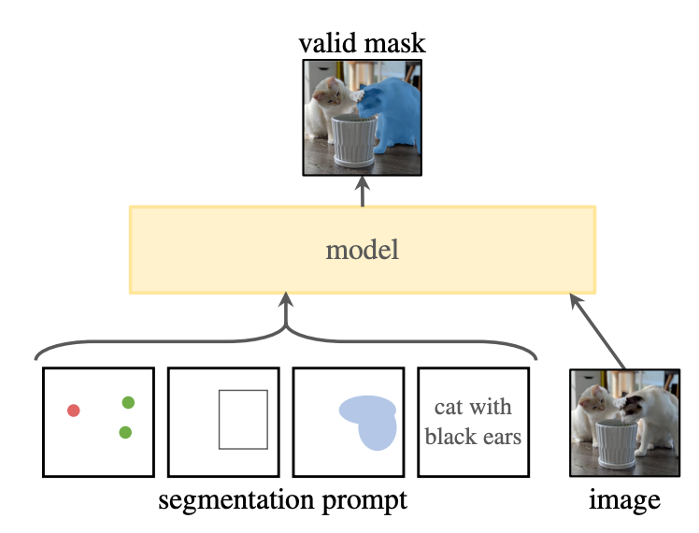
Promptable Segmentation
ChatGPT: prompt-based model
Creates output according to user-defined task and specifications
Similarly, SAM needs:
High promptability: NLP (Text) + 2D prompts (Points, Boxes)
High generalizability: Output (Mask) must be valid regardless of Input (prompt) ambiguity
Thus, Promptable Segmentation:
Task that allows flexible prompting of a target to create segmentation masks!
AIoT Lab Meeting
Notes:
ChatGPT: prompt based model
사용자의 주문에 맞게, 다양한 task에 맞는 아웃풋을 낸다
이와 유사하게 자연어 및 다양한 지시가 가능(promptable)해야 하고, generalizability가 뛰어나야 함
Prompt가 모호하더라도 “유효한” 결과 mask를 내놓아야 함
즉, segmentation mask를 생성하고자 하는 대상을 유연하게 prompt로 지정할 수 있는 task!
A task that allows you to flexibly prompt a target to create a segmentation mask!

Slide 10
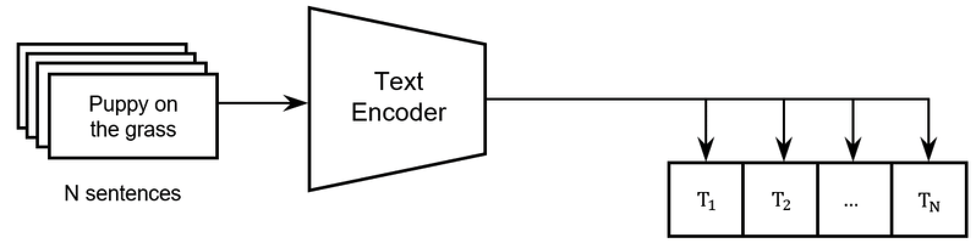

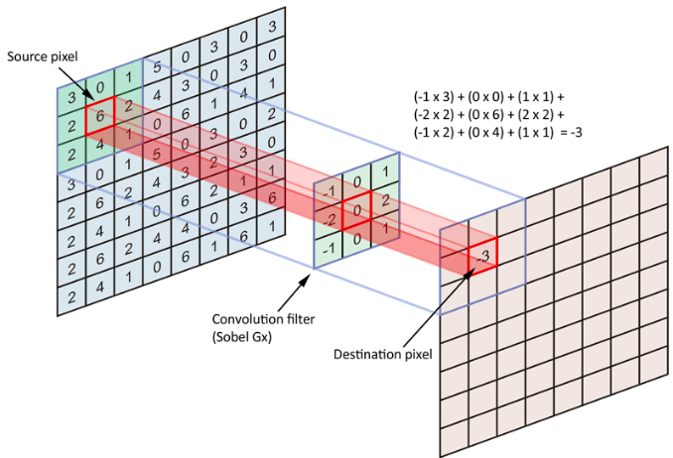
Defining the SAM Prompt
SAM prompts = any combination of sparse and dense prompts
Sparse prompts:
Text - CLIP text-encoder embeddings Points & Boxes - Positional Encodings
Dense prompts: Masks - Convolution
AIoT Lab Meeting
Notes:
Training: 각 prompt 종류 별로 mask를 취득 -> GT mask와 비교하는 방식으로 진행

Slide 11
Training Prompt Segmentation
Zero-shot Transfer
Pre-training: Acquire masks from each prompt → Compare to Ground Truth masks
End-goal: Mask inference from user prompt based on pre-trained SAM model
Valid mask prediction must be prompt permutation invariant
Pre-training design should result in better “zero-shot” performance on new images and new tasks
To verify this zero-shot transfer:
Evaluate performance on tasks other than Image Segmentation
AIoT Lab Meeting

Slide 12
Model: What is the model architecture?
AIoT Lab Meeting

Slide 13
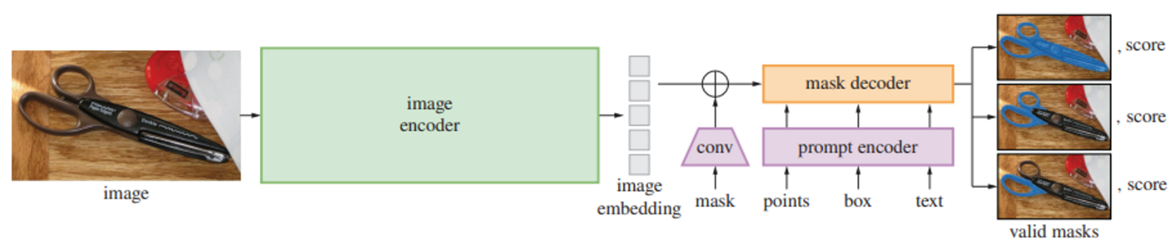
Overall Architecture
AIoT Lab Meeting

Slide 14
Image Encoder
Pre-trained Vision-Transformer model: allows high resolution image processing
High scalability: operates once per image during initial encoding
No need for real-time operation
Image size: 1024 x 1024 pixels
Automatic padding on smaller images to match dimensions
AIoT Lab Meeting
Notes:
Pre-trained된 Vision-Transformer 모델 사용(고해상도 이미지 처리를 위해)
이미지 당 최초 한 번만 동작 / 실시간성을 요구하지 않아 높은 스케일의 모델을 사용 가능
Input image는 1024 x 1024 / 원본이 square가 아닌 이미지는 짧은 부분에 padding

Slide 15
Prompt Encoder
Points, Boxes → Positional Encoding → Prompt Embedding
Text → CLIP Text-encoder → Prompt Embedding
Masks → Convolution → Pixel-wise sum onto Image Embedding
Process takes ~50ms in a Web environment (CPU)
AIoT Lab Meeting
Notes:
Point & Box: positional encoding을 거쳐 prompt embedding으로
Text: CLIP 모델의 text-encoder를 거쳐 prompt embedding으로
Mask: convolution을 거쳐 image embedding에 point-wise-sum
Web 환경 (CPU)에서 ~50ms 내에 작동함

Slide 16
Mask Decoder
Mask decoder inputs:
Input Embedding
Prompt Embeddings
Output Tokens = Prompt encoder output, summed by each type of prompt embedding
Decoder maps the inputs to one of 3 valid masks and its respective scores
Process takes ~50ms in a Web environment (CPU)
AIoT Lab Meeting
Notes:
Web 환경 (CPU)에서 ~50ms 내에 작동함

Slide 17
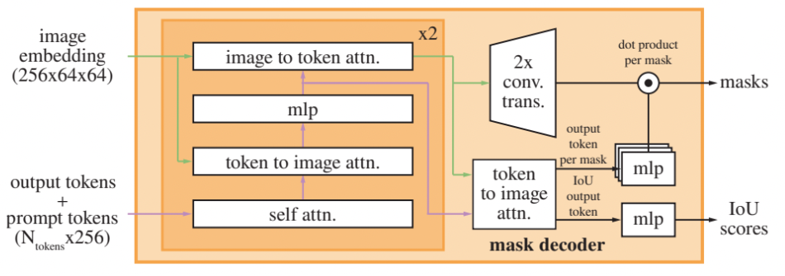
Mask Decoder Sequence
Prompt self-attention
Cross-attention between prompt & image embeddings
4) Attention on tokens with image embedding as query
Self attention on prompt tokens
2) Attention on image embedding with tokens as query
3) Pixel-wise MLP to update each token (each prompt embeddings)
AIoT Lab Meeting
Notes:
Decoder layer 동작 단계
Prompt token에 대한 self-attention
Token을 query로 하여 image embedding에 attention
Point-wise MLP로 각 token(각각의 prompt embedding)을 업데이트
Image embedding을 query로 하여 token에 attention

Slide 18
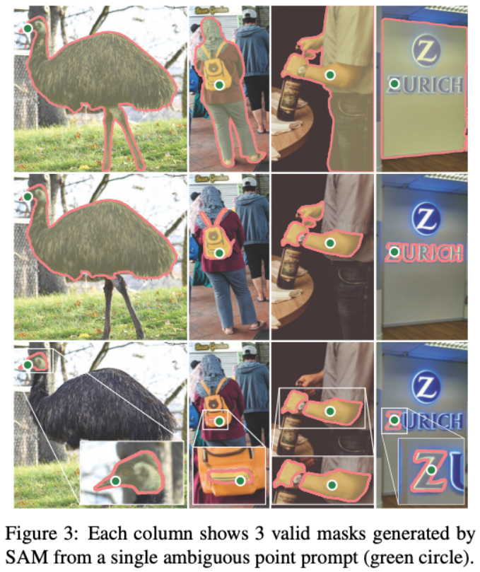
Resolving Ambiguity
Ambiguity: Unclear intent of what object the masked area is for
Ex) Point prompt intended for bird’s beak? head? or its entirety?
Model outputs 3 candidate masks and scores for each prompt
Whole / Part / Subpart
Backpropagation based on the mask with highest IoU score
AIoT Lab Meeting

Slide 19
Loss & Training
Focal Loss:
Weight more on objects that are harder to detect
Dice Loss:
How much of the Ground Truth was incorporated?
vs
Masks) 20:1 ratio of Focal Loss and Dice Loss
IoU Score Prediction) MSE between IoU Prediction and Ground Truth
Mask Loss : IoU Loss = 1 : 1
AIoT Lab Meeting

Slide 20
Data: How to create an appropriate Dataset?
AIoT Lab Meeting

Slide 21
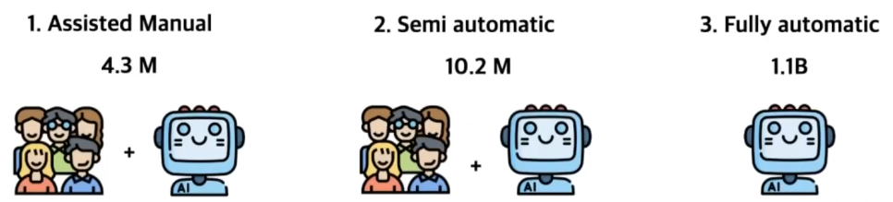
Data Engine
In order for sufficient zero-shot capability, SAM needs a large, diverse database
Unlike text data, Segmentation Masks cannot be easily collected, and require manual labor
Solution: Create proprietary “Data Engine” that collects masks en masse
AIoT Lab Meeting
Notes:
모델이 zero-shot capability를 가질 수 있도록, 충분하고 다양한 데이터가 필요
텍스트 데이터와 달리, segmentation mask는 손쉽게 구하기 어려움(수작업 필요)
따라서, 대규모의 mask 취득을 위해 자체 “Data Engine”을 구현

Slide 22
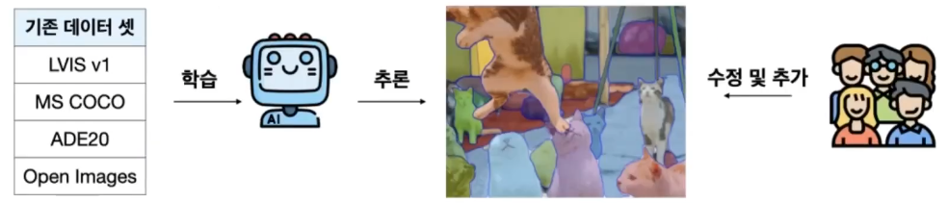
1) Assisted-manual stage
Train on existing datasets → Output initial AI segmentations → Humans fix/add masks for 30 sec
Time limit exists to encourage the AI to create/edit masks
Repeat the process 6 times, updating data each time
AI annotation time reduces from 34 → 14 seconds per image
Result) 4.3 million masks from 120,000 images
AIoT Lab Meeting
Notes:
현존하는 데이터셋으로 SAM 학습 -> AI가 Segmentation 하면 사람이 이를 수정/추가
Annotator(사람)는 이미지 당 30초 마스킹
데이터를 업데이트하면서, 위 과정을 6번 반복
재학습 할 때마다 Annotating time이 34초 -> 14초로 감소
12만개 이미지로부터 4300만개의 mask를 취득

Slide 23
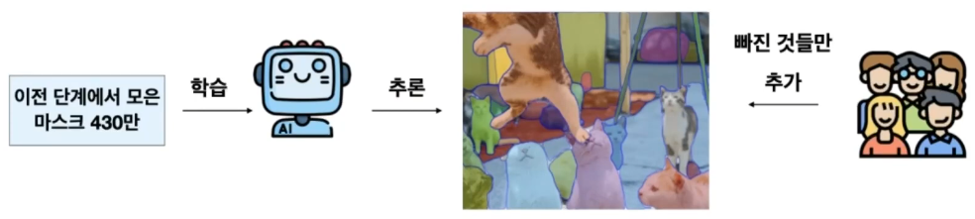
2) Semi-automatic stage
Train SAM on data from Stage 1) → Output AI segmentations
This time, human annotators only ADD missing segmentations
Repeat process 5 times, updating data each time
Result) 5.9 million masks from 180,000 images
AIoT Lab Meeting
Notes:
이전 단계에서 모은 데이터로 SAM 학습
-> AI가 segmentation 하면 사람이 빠진 것 채워 넣음
데이터를 업데이트하며, 총 5번의 재학습
18만개 이미지로부터 590만개의 mask를 취득

Slide 24
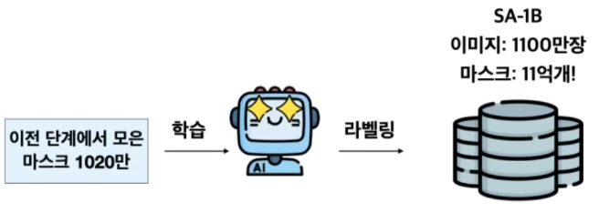
3) Fully-automatic stage
# of Masks: 4.3 million (stage 1) + 5.9 million (stage 2) = 10.2 million masks
Using this database, train SAM on segmentation
Fully automated, with no human annotator input
Model became ambiguity-aware in this stage of data engine training
Result) 1.1 billion masks from 11 million images
AIoT Lab Meeting

Slide 25
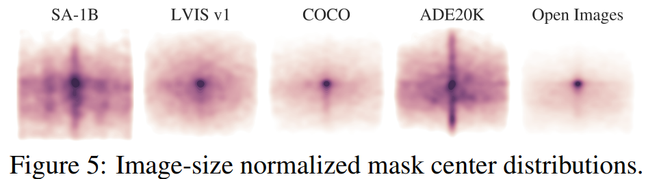
Final Dataset: SA-1B
Images
Mean image size = 3300 x 4950 pixels
Downsample to 1500 pixels based on smaller axis to counteract images growing too large
Privacy-friendly: Blurred out License plates, faces, etc.
Masks
99.1% of masks generated from final stage
SA-1B only includes automatically generated masks
Mask Properties
Figure 5) Mask centers are more evenly distributed than other datasets
Indication of better masking of objects in various locations of the image
AIoT Lab Meeting
Notes:
Image
평균적으로 3300 x 4950(pixels)의 이미지를 취득.
이미지의 크기가 너무 커지는 것을 고려: 짧은 쪽 기준 1500 pixel로 downsample
차량 번호판, 얼굴 등 privacy와 관련된 것은 블러 처리
Masks
만들어낸 11억개의 mask 중에서 99.1%는 완전 자동 단계에서 취득
SA-1B dataset에는 자동으로 취득한 mask만 포함시킴
Mask Property
Mask의 중심 위치 분포가 다른 데이터셋들보다 더 고르게 분포되어 있음
즉, 다양한 위치의 object에 대하여 masking을 잘 수행함

Slide 26
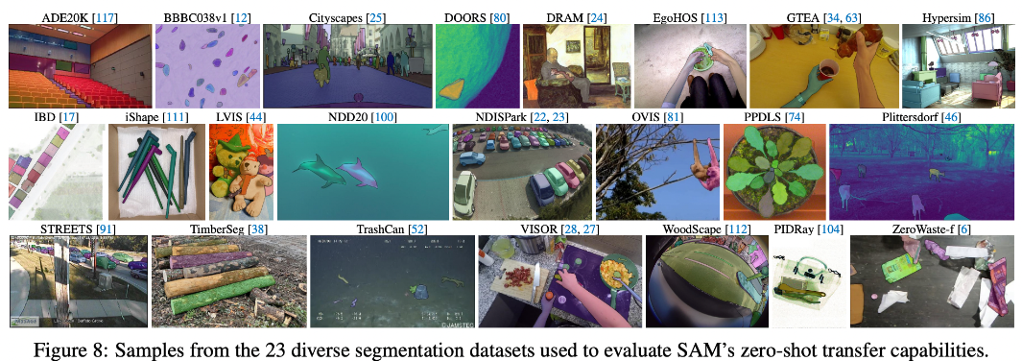
Experiments: What can SAM do?
AIoT Lab Meeting

Slide 27
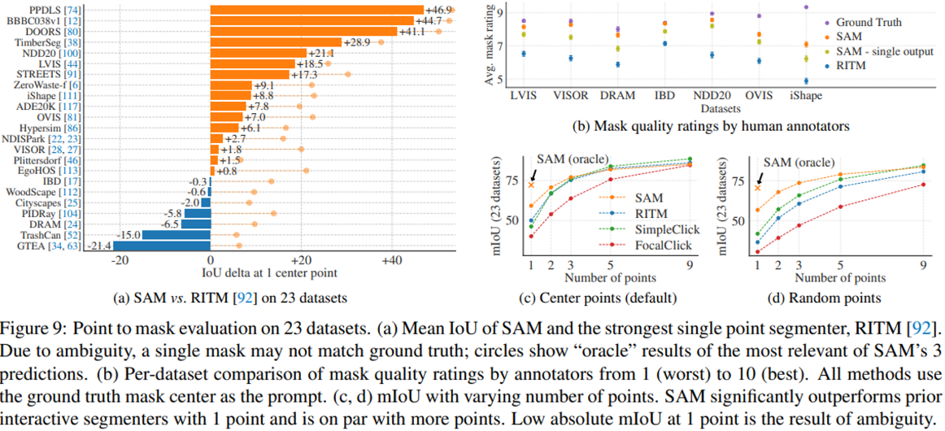
Zero-shot Single Point Valid Mask Evaluation
Given one point, segment the object that the point belongs to
AIoT Lab Meeting
Notes:
점을 하나 찍고, 그 점이 해당하는 object를 segmenting하는 task

Slide 28
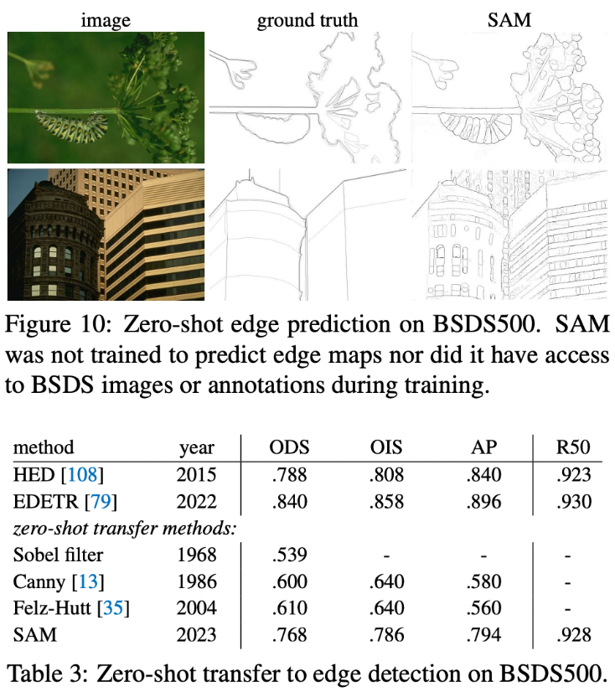
Zero-shot Edge Detection
Given an image, output the edges of objects in the image
Edges: Leave only edges through Sobel Filtering
Performance:
Detects more edges than the Ground Truth
Even though SAM not an edge-detection model, performs as well as SOTA edge models
Shows highest performance out of zero-shot transfer methods
AP = mask IoU
AIoT Lab Meeting
Notes:
이미지가 주어졌을 때 테두리를 따내는 task
Edge: Sobel Filtering으로 테두리만을 남김(후처리)
Edge detection으로 학습 안했어도 괜찮은 성능을 보인다
GT보다 더 많은 테두리를 검출
Zero-shot transfer 중에서 가장 좋은 성능을 보임

Slide 29
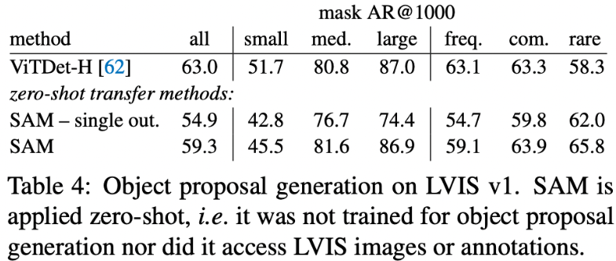
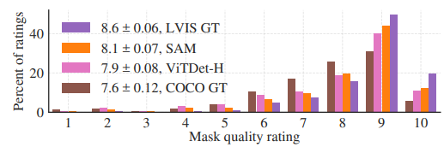
Zero-shot Object Proposals
Identify candidate areas for a specific object to exist at
Similar performance to SOTA models except small objects
Keep in mind: SAM is a zero-shot transfer learning method
On the other hand, detects rarer objects better than SOTA models
Has higher mask quality ratings than other datasets
AIoT Lab Meeting
Notes:
작은 물체를 제외하고는 SOTA와 비슷한 성능을 보임
심지어 SOTA와 달리 Zero-shot임 → transfer learning 관점에서 zero-shot
Rare한 물체는 더 잘 찾는다 -> 더 general하다
정성 평가에서 더 좋은 평가

Slide 30
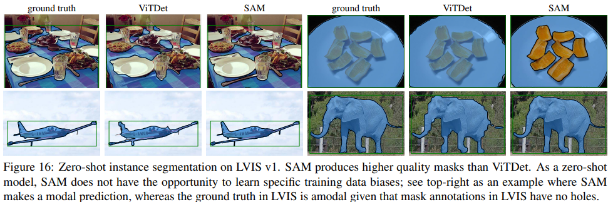
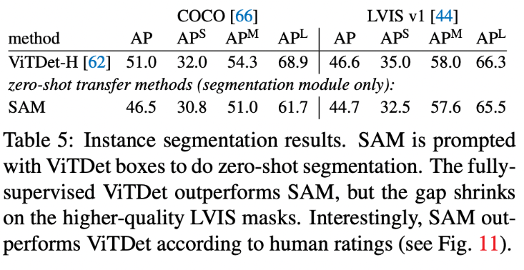
Zero-shot Instance Segmentation
Segment objects that have been identified by an Object Detection Task (ViTDet → SAM)
AIoT Lab Meeting
Notes:
Object detection으로 검출한 object에 대해 segmenting하는 task
(Obj detector = ViTDet -> 이후 SAM으로 segmentation)

Slide 31
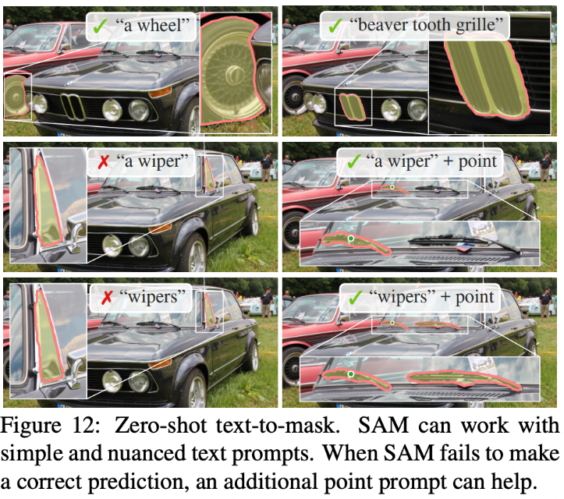
Zero-shot Text-to-Mask
Segmentation based on prompts with text information
Learns well even without text labels
Performance measures not published → May indicate lower performance compared to SOTA
Nevertheless, a “text + point” prompt improves the performance
AIoT Lab Meeting
Notes:
Prompt에 텍스트 정보를 포함해 segmenting하는 task
별도의 text label이 없어도 학습이 가능하다(prompt)
논문에는 정량적인 평가가 빠져 있음 (웹 데모에서도)
텍스트와 함께 point를 지정해주면 나아짐

Slide 32
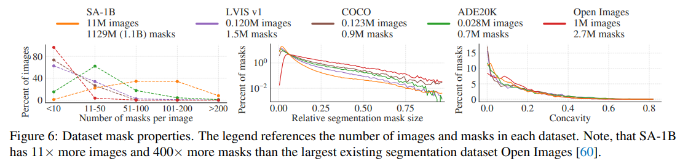
Mask Quality
Masks are smaller (= more precise)
# of masks per image is highest
Random sampling of 500 images (and 50,000 masks) from SA-1B
Annotators edit the sampled masks → used as Ground Truth
Compare SA-1B mask and Ground Truth masks → IoU score
Achieved 85~91% IoU (similarity between generated and Ground Truth masks)
AIoT Lab Meeting
Notes:
SA-1B의 마스크와 GT의 마스크를 비교(IoU)
85~91%의 IoU 기록
94% pair가 90%이상의 IoU / 97% pair가 75% 이상의 IoU

Slide 33
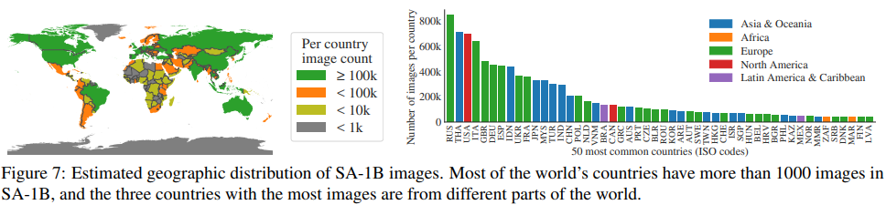
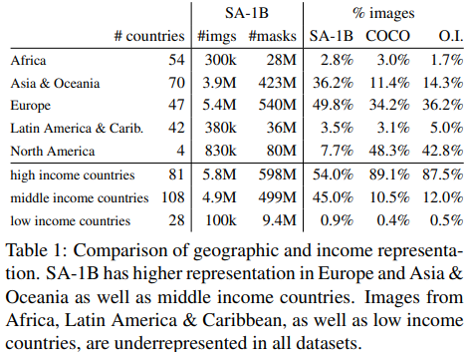
Data Fairness
1) Geographic & Income Fairness
Top 3 countries in different continents
>1k data on most countries
Incorporates previously less sampled continents &
middle/low income countries more
AIoT Lab Meeting
Notes:
기존에 소외되었던 지역
&
중/저소득 국가의 데이터를 더 많이 포함

Slide 34
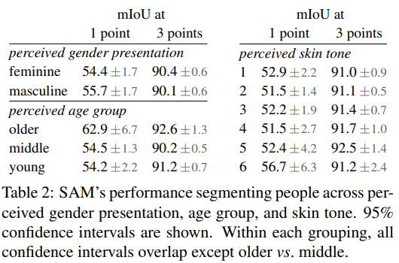
Data Fairness
2) Fairness in segmenting people
AIoT Lab Meeting

Slide 35
Conclusion
AIoT Lab Meeting

Slide 36
Summary
Significance of the attempt to create a Foundation model based on Image segmentation
Consideration of a new task (Promptable Segmentation), model (SAM), and dataset (SA-1B)
Creation of its own large dataset, SA-1B, for Image Segmentation
Novel model architecture that receives multi-modal inputs
In conclusion, presents a Foundation Model that achieves its goal:
Promptability
Generalizability for zero-shot tasks
AIoT Lab Meeting

Slide 37
Limitations
Rather than focus on the performance (IoU) of segmentation, focused on the generalizability and performance in zero-shot transfer learning
Prompt to Mask Output is in real time, but the entire system is not in real time
Initial image encoding
Text-to-Mask task performance is the lowest out of the zero-shot transfer tasks
Cannot conclude that Ambiguity has been completely removed
AIoT Lab Meeting
Notes:
Segmentation의 성능(IoU)를 높이기 보다는 generality에 초점
Prompt -> mask output은 realtime이지만, 전체 시스템이 realtime은 아님
Text-to-mask는 불안정 + 낮은 성능
Ambiguity 완전히 해결했다고 보기는 힘들다

Slide 38
THANK YOU!
AIoT Lab Meeting
Notes:
Segmentation의 성능(IoU)를 높이기 보다는 generality에 초점
Prompt -> mask output은 realtime이지만, 전체 시스템이 realtime은 아님
Text-to-mask는 불안정 + 낮은 성능
Ambiguity 완전히 해결했다고 보기는 힘들다

